Slide 1
LEARNING HOW TO LEARN
Presenter: Brian Tran

Slide 2
TABLE OF CONTENTS
Model of thinking
Focus mode
Defused mode
Overlearning
Which mode better for learning/ working.
Summary.
Procrastination
Procrastination solution
Set to-do early sleep
Focus on process vs on the product
Learn how to manage distractions
Pomodoro
System of memory
How to gain long-term memory
Chunking
Look for a big picture
Interleaving
Avoid illusion of competence

Slide 3
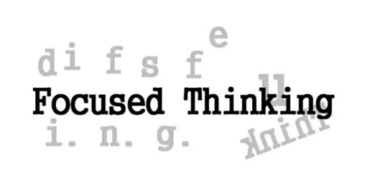
Model of thinking
When we are solving a problem, there are two ways, we can consider it: using focused thinking or using diffuse thinking

Slide 4
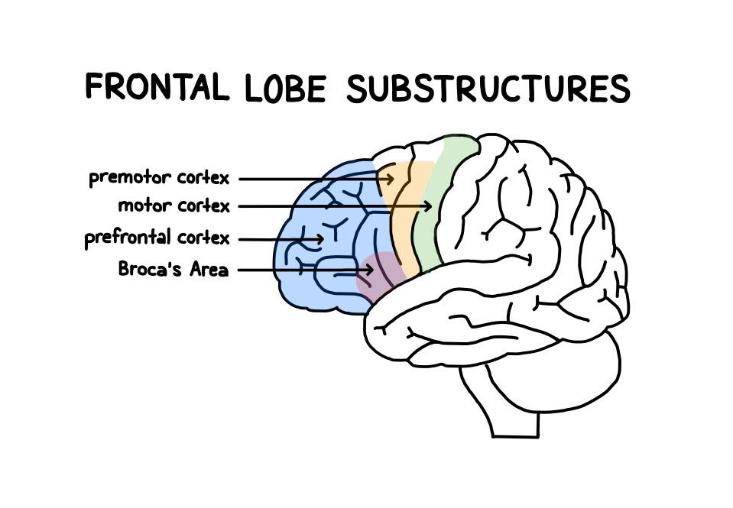
1- Focused thinking
Is when we are really concentrating on the matter at hand.
Focused thinking is a highly attentive state of mind where the brain uses its bet concentration abilities in the prefrontal cortex to ignore all extraneous information

Slide 5
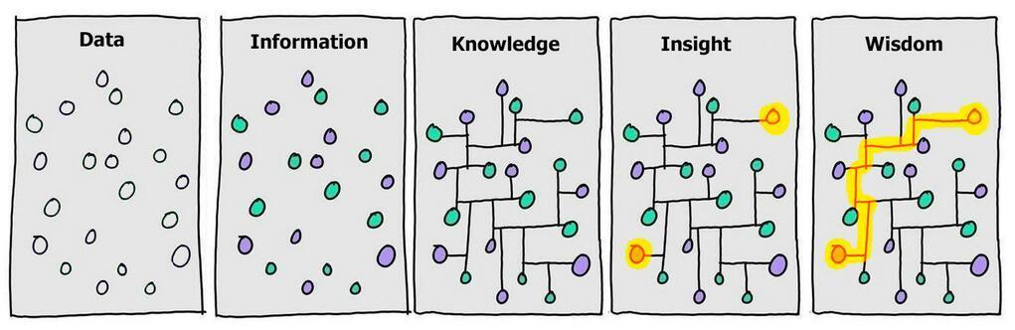
2 – Diffuse thinking
Looks at the big picture
Unlike focused thinking, diffuse thinking is about distraction.
Diffuse thinking happens when you let your mind wander freely, making connections at random.
The diffuse mode of thinking does not happen any one area of the brain, but rather all over. In fact, that is the beautify of diffuse thinking: You brain has the opportunity of to connect the tots and link neural processes.

Slide 6
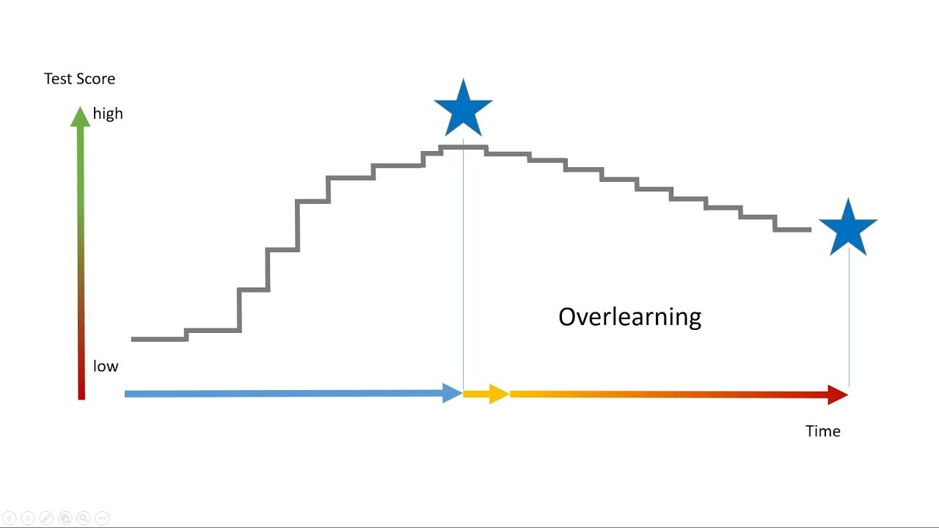
Overlearning

Slide 7
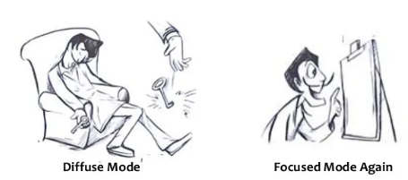
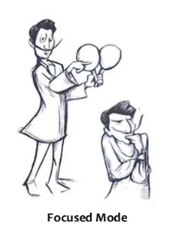
Which mode is best for learning?
Alternating between them both!
Watch this video that mentions how Salvador Dali and Steve Job used both modes to learn.

Slide 8

Focused vs Diffuse Thinking: Why Engineer Need to Master Both Parts of Their Mind

Slide 9
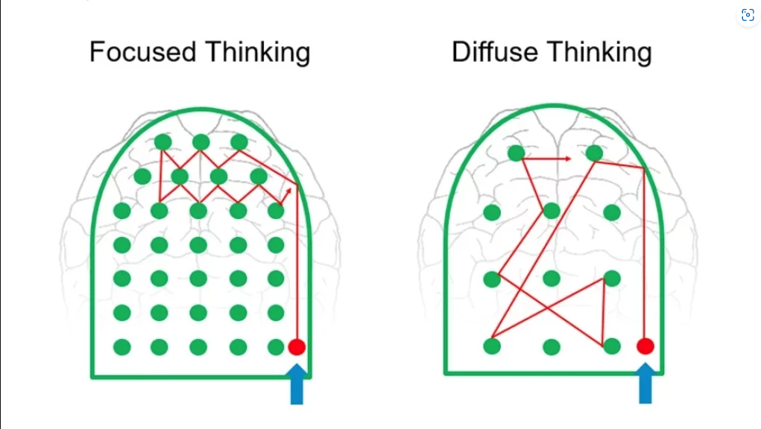
Thinking Mode Summary
Focused-mode thinking involves a direct approach to solving problems using rational, sequential, analytic approaches. The focused mode í associated with concentrating abilities of the brains’ prefrontal cortex. Turn you attention to something and the focused mod is on
Diffuse-mode thinking is what allows us to suddenly gain a new insight on a problem we’ve been struggling with and is associated with big picture perspectives. Diffuse-mode thinking is what happens when you relax your attention and just let you mind wander

Slide 10

Procrastination
Why do we procrastinate? Why don’t enjoy the task we are doing?
We are afraid of failure
We are afraid of imperfection
We are overwhelmed

Slide 11
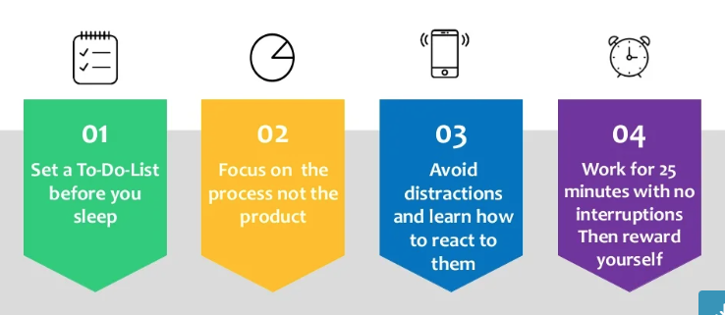
Procrastination Solution

Slide 12

Set a To-do-list before you sleep
Do it before night you sleep
Don’t cram it with a lot of task
Be reasonable
Set the time you want to finish
Make it fun as well

Slide 13
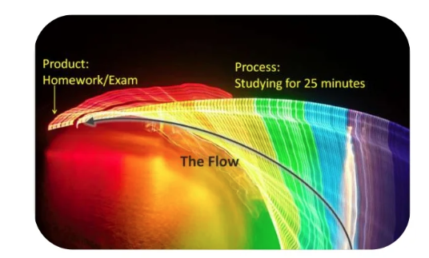





Focus on the process no the product

Slide 14

Avoid distractions and learn how to react to them

Slide 15
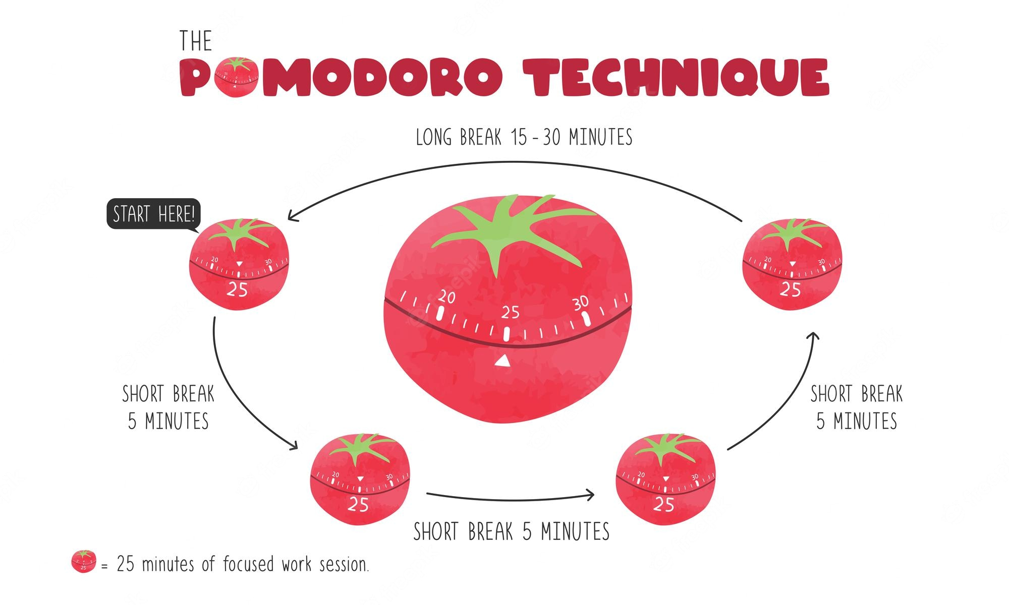
Work for 25 minutes with no interruptions. Then reward yourself

Slide 16
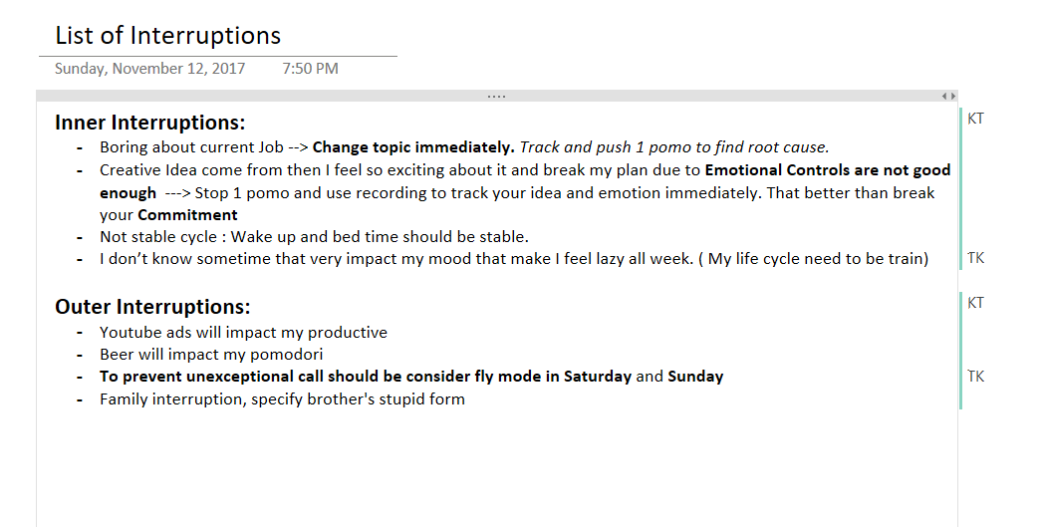
EXAMPLE

Slide 17

`Backlog for your life, agile is da best`

Slide 19
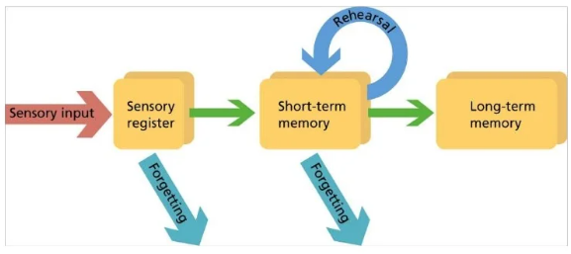
System of memory
Short-term memory differs from long-term memory in two fundamental ways, with only short-term memory demontrating temporal decay and capacity limits. Long-term memory, however, can store vast amounts of information and is permanent

Slide 20
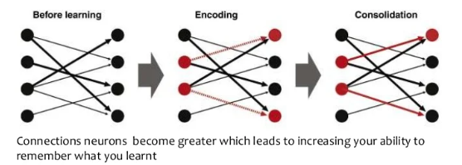
How to gain long-term memory?
Practice make permanent ( REPETITION )
Just as weightlifting and physical exercise builds your muscles, when you’re learning or working the nerve cells in your brain are growing with mental exercise and these neurons are developing greater connectivity.
The growth and rewiring of our brain cell is called neuroplasticity.

Slide 21
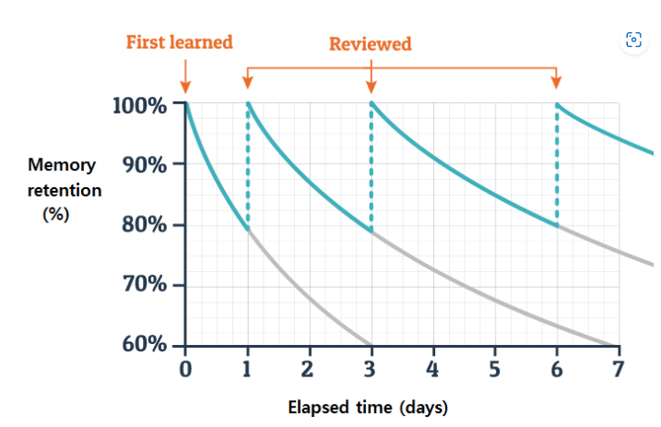
How to gain long-term memory?
2. Spaced repetition
Because we haven’t stored the information in the long-term part yet.

Slide 22
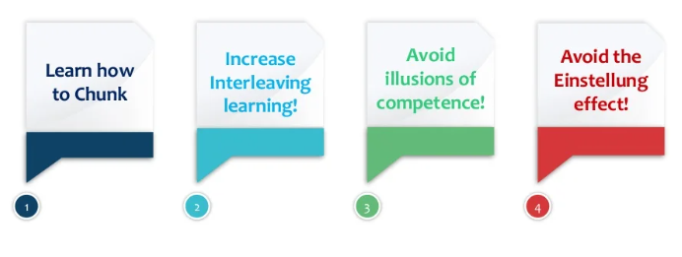
Now it’s time to start learning efficiently

Slide 23
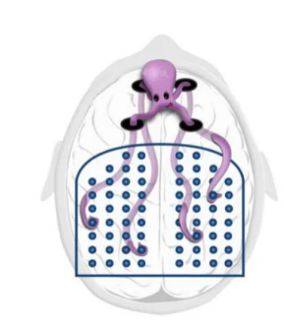
Chunking
Chunking refers to the strategy of breaking down information into bite-sized pieces so the brain can more easily digest new information.
Also, it will let your brain recall them all together much master in the future ( because you are using on tenacle out of you “octopus of attention and diffuse tentacles)

Slide 24
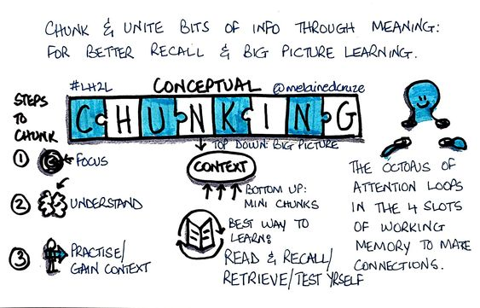

Slide 25

Look for the big picture
Before starting a new chapter (EPIC, US) look for the big picture by for example:
Reading the tiles of the chapter’s (EPIC, US) subsection
Reading first paragraph of each section
Going through the questions at the end of chapter (EPIC, US)
That way when you read it you will know what you should focus on.

Slide 26
interleaving
Interleaving is a process where students mix, or interleave, multiple subjects or topics
while they study in order to improve their learning.

Slide 27
Avoid illusion of competence
Illusion of competence describes a mental siuation where you think you’ve mastered a set of material but your really haven’t.
Always test your self ( recall)
Test yourself in multiple locations (context)
Minimize
highlighting
Mistake are good
Use deliberate practice

Slide 28
Avoid Einstellung Effect
Einstellung is the development of a mechanized state of mind which refers to a person’s predisposing to solve a given problem in a specific manner even though better or more appropriate methods of solving the problem exist.
The Einstellung effect is the negative effect of previous experience when solving new problems.
The Einstellung effect has been tested experimentally in many different contexts. The most famous example is the Luchins’ water jar experiments. In which subjects were asked to solve a series of water jar problems. After solving many problems which has the same solution, subjects applied the same solution to later problems even though a simple solution existed (Luchins, 1942)

Slide 29

Don’t keep knowledge only for yourself, share it.

Slide 30
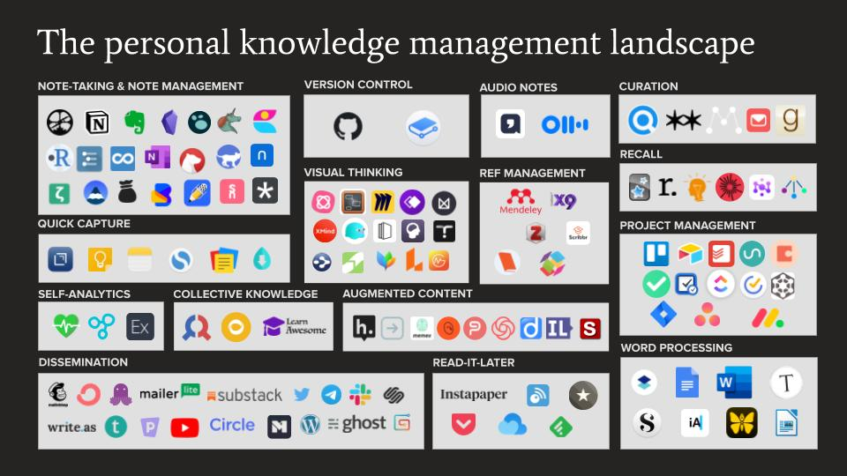
Obsidian - Công cụ cho dev và researcher ghi chú và quản lý kiến thức cá nhân một cách hiệu quả (viblo.asia)

Slide 31

Thank you

